Slide 1
EXECUTIVE MARKETING STRATEGY & BEHAVIORAL ANALYSIS
Converting Casual Riders into High-Value Members
Empirical insights from 4.58M rides in 2025 guiding targeted digital conversion campaigns
Marketing Analyst Team
Director of Marketing: Lily Moreno
Cyclistic Bike-Share Chicago • 2025/2026

Slide 2



The Core Business Task & Strategic Mandate
Business Objective
Financial Rationale
Growth Strategy
Maximize long-term revenue through annual membership conversions.
Finance analysts proved annual members are significantly more profitable.
Convert aware casual riders rather than acquisition of cold leads.
Primary Analytical Question: How do annual members and casual riders use Cyclistic bikes differently?
KEY STAKEHOLDER: LILY MORENO

Slide 3
Data Architecture, ROCCC & Privacy Compliance
Source Integrity
ROCCC Validation
Privacy & Security
Direct monthly logs provided by Motivate International Inc. under open license.
Verified as Reliable, Original, Comprehensive, Current (2025), and Cited.
Strict zero PII safeguards preventing credit card or personal ID tracking.
Fleet Scale
Annual Scope
5,824 bicycles operating across 692 Chicago docking stations.
12 continuous monthly datasets consolidating over 4.5M raw trips.

Slide 4
Technical Data Processing & Quality Audit
01
02
03
Deduplication
Anomaly Filtering
Feature Engineering
Zero duplicate ride IDs verified across all 12 ingested files.
Eliminated trips under 1 minute and system maintenance rides over 24h.
Calculated ride length in minutes and weekday names for behavioral analysis.
Data Pipeline Tools: Python (Pandas batch consolidation) • Excel openpyxl • Tableau Public Visualizations

Slide 5
2025 High-Level Ridership Overview
4.58M
64.0%
1.98x
Total Annual Cleaned Trips
Annual Member Ride Share
Casual / Member Duration Ratio
Across entire Chicago metropolitan network
2,933,062 rides logged by committed commuters
Casual rides avg 24.6 min vs 12.4 min for members
Key Strategic Takeaway: Casual riders represent 36.0% of ridership (1.65M trips) and spend twice as long per trip, representing substantial potential membership value.

Slide 6

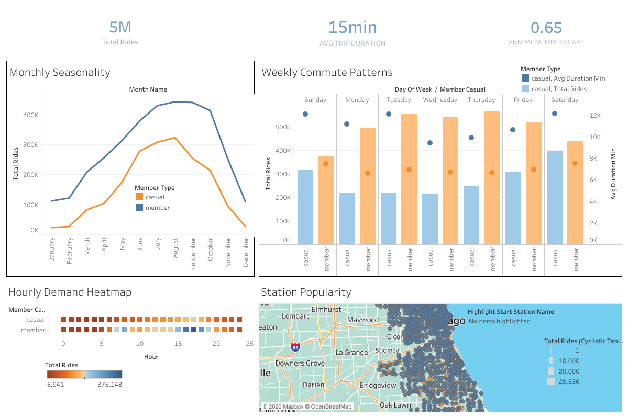
Comprehensive Multi-Pane Tableau Dashboard
Source: cyclistic_tableau_aggregated.csv • cyclistic_tableau_stations.csv

Slide 7
Seasonality: Peak Summer vs. Year-Round Utility
Casual Rider Summer Surge
62.3% of annual casual rides happen between June and September alone.
STRATEGIC MARKETING WINDOW
Stable Commuter Baseline
May – Aug
Members maintain steady utilization across 9 to 10 months annually.
All conversion ad spend and on-site promotions must deploy during these 4 high-exposure months.
Winter Contraction
Casual usage plummets to 5.3% in winter while member transit continues.

Slide 8
Weekday Transit vs. Weekend Recreation
Annual Members
Casual Riders
78.5% of all trips occur Monday through Friday.
44.8% of total volume concentrated on Saturday and Sunday.
Heatmap proves acute spikes at 8:00 AM and 5:00 PM.
Heatmap shows steady midday ramp from 12:00 PM to 4:00 PM.
Consistent, direct commutes averaging 11.8 to 12.3 minutes.
Weekend leisure duration peaks at 28.1 minutes.
Strategic Synthesis: Casual users treat Cyclistic as entertainment, while members treat it as essential daily transit.

Slide 9
Spatial Corridors & Fleet Selection
Transit Hubs
Waterfront Tourism
Electric Adoption
Members cluster at commercial stations: Clinton & Washington, Kingsbury & Kinzie.
Casual rides anchor at Navy Pier, Lake Shore Drive, and Millennium Park.
Casual users choose electric bikes and scooters at 50.6% vs 40.5% for members.
Conversion Venue: Physical QR promotions should be localized precisely to coastal docking stations where casual riders initiate and end trips.

Slide 10
Top 3 Actionable Recommendations for Marketing
1
2
3
Seasonal Pass Tier
Geo-Targeted Promos
Electric Fleet Perks
Launch a 4-month Summer Membership rolling over into annual plans.
Deploy digital in-app upgrade nudges at high-volume waterfront hubs.
Offer free e-bike unlock minutes bundled into the annual membership pass.
Expected Impact: Lowers barrier to entry for leisure riders while locking in predictable annual recurring revenue.

Slide 11
Digital Media & Campaign Rollout Timeline
PHASE 1: MARCH – APRIL
PHASE 2: MAY – AUGUST
PHASE 3: SEPTEMBER
Early Bird Trials
Geo-Targeted Push
End-of-Season Rollover
Launch email invitations offering 30-day spring trial passes.
Deploy weekend station QR codes and cost-comparison savings calculators.
Credit summer single-ride fees directly toward full 2026 annual renewals.
KPI Tracking: Track conversion rate of single pass users, summer pass rollover percentage, and average customer lifetime value (LTV).

Slide 12
CYCLISTIC MARKETING ANALYTICS TEAM
Ready for Executive Sign-Off & Implementation
Converting aware casual riders into loyal members drives predictable, high-margin growth.
Questions & Discussion with Lily Moreno and Executive Leadership

